Slide 1

Data Mining and Machine Learning (CSE 321)
Summer 2021
Topic – 8: Cluster Analysis
Course Teacher:
Md. Tarek Habib
Assistant Professor
Department of Computer Science and Engineering
Daffodil International University
Notes:
786
Md. Tarek Habib

Slide 2


Topic Contents
  Overview
  K-means
  Hierarchical Clustering

Slide 3
Recommended Reading
“Introduction to Data Mining,” Pang-Ning Tan, Michael Steinbach and Vipin Kumar, Addison Wesley, 2006.
    Chapter 8 (Cluster Analysis: Basic Concepts and Algorithms)

Slide 4
What is Cluster Analysis?
Finding groups of objects such that the objects in a group will be similar (or related) to one another and different from (or unrelated to) the objects in other groups
Inter-cluster distances are maximized
Intra-cluster distances are minimized

Slide 5
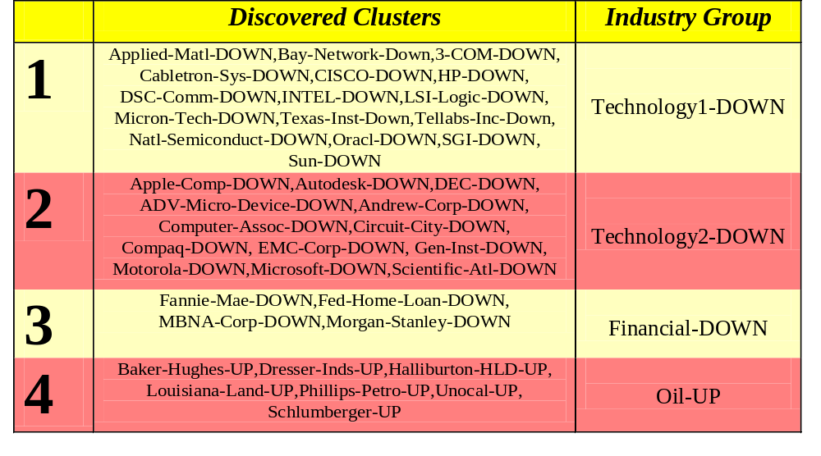
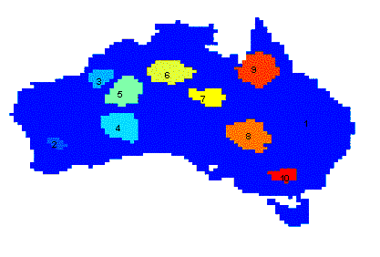
Applications of Cluster Analysis
Understanding
  Group related documents for browsing, group genes and proteins that have similar functionality, or group stocks with similar price fluctuations
Summarization
  Reduce the size of large data sets
Clustering precipitation in Australia

Slide 6
Notion of a Cluster can be Ambiguous
How many clusters?
Six Clusters
Two Clusters
Four Clusters

Slide 7
Types of Clusterings
A clustering is a set of clusters
Important distinction between hierarchical and partitional sets of clusters
Partitional Clustering
  A division data objects into non-overlapping subsets (clusters) such that each data object is in exactly one subset
Hierarchical clustering
  A set of nested clusters organized as a hierarchical tree

Slide 8

Partitional Clustering
Original Points
A Partitional Clustering

Slide 9
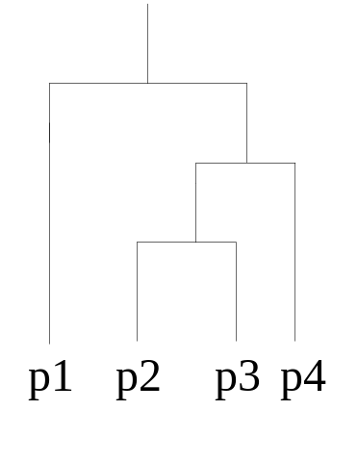
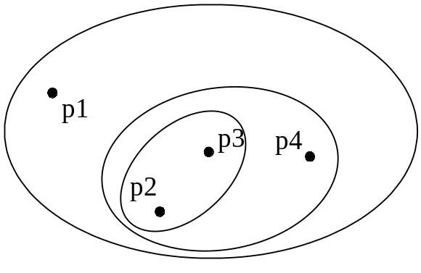
Hierarchical Clustering
Traditional Hierarchical Clustering
Traditional Dendrogram

Slide 10
Other Distinctions Between Sets of Clusters
Exclusive versus non-exclusive
  In non-exclusive clusterings, points may belong to multiple clusters.
  Can represent multiple classes or ‘border’ points
Fuzzy versus non-fuzzy
  In fuzzy clustering, a point belongs to every cluster with some weight between 0 and 1
  Weights must sum to 1
  Probabilistic clustering has similar characteristics
Partial versus complete
  In some cases, we only want to cluster some of the data
Heterogeneous versus homogeneous
  Cluster of widely different sizes, shapes, and densities

Slide 11
Types of Clusters
Well-separated clusters
Center-based clusters
Contiguous clusters
Density-based clusters
Property or Conceptual
Described by an Objective Function

Slide 12
Types of Clusters: Well-Separated
Well-Separated Clusters:
  A cluster is a set of points such that any point in a cluster is closer (or more similar) to every other point in the cluster than to any point not in the cluster.
3 well-separated clusters

Slide 13
Types of Clusters: Center-Based
Prototype/Center-based
  A cluster is a set of objects such that an object in a cluster is closer (more similar) to the (prototype) (e.g.,“center”) of a cluster, than to the center of any other cluster
  The center of a cluster is often a centroid, the average of all the points in the cluster, or a medoid, the most “representative” point of a cluster
4 center-based clusters

Slide 14
Types of Clusters: Contiguity-Based
Contiguous Cluster (Nearest neighbor or Transitive)
  A cluster is a set of points such that a point in a cluster is closer (or more similar) to at least one point in its cluster than to any point not in the cluster.
8 contiguous clusters

Slide 15
Types of Clusters: Density-Based
Density-based
  A cluster is a dense region of points, which is separated by low-density regions, from other regions of high density.
  Used when the clusters are irregular or intertwined, and when noise and outliers are present.
6 density-based clusters

Slide 16
Types of Clusters: Conceptual Clusters
Shared Property or Conceptual Clusters
  Finds clusters that share some common property or represent a particular concept.
  .
2 Overlapping Circles

Slide 17
Clustering Algorithms
K-means and its variants
Hierarchical clustering
Density-based clustering

Slide 18

K-means Clustering
Partitional clustering approach
Each cluster is associated with a centroid (center point)
Each point is assigned to the cluster with the closest centroid
Number of clusters, K, must be specified
The basic algorithm is very simple

Slide 19
K-means Clustering – Details
Initial centroids are often chosen randomly.
  Clusters produced vary from one run to another.
The centroid is (typically) the mean of the points in the cluster.
‘Closeness’ is measured by Euclidean distance, cosine similarity, correlation, etc.
K-means will converge for common similarity measures mentioned above.
Most of the convergence happens in the first few iterations.
  Often the stopping condition is changed to ‘Until relatively few points change clusters’
Complexity is O( n * K * I * d )
  n = number of points, K = number of clusters,
  I = number of iterations, d = number of attributes

Slide 20



Two different K-means Clusterings
Original Points
Optimal Clustering
Sub-optimal Clustering

Slide 21






Importance of Choosing Initial Centroids

Slide 22
Importance of Choosing Initial Centroids

Slide 23
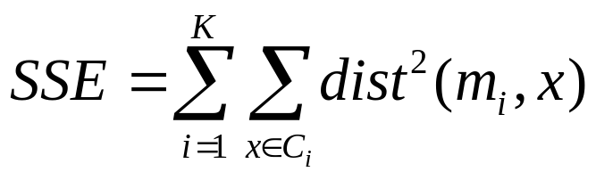
Evaluating K-means Clusters
Most common measure is Sum of Squared Error (SSE)
  For each point, the error is the distance to the nearest cluster
  To get SSE, we square these errors and sum them.
  x is a data point in cluster C_{i} and m_{i} is the representative point for cluster C_{i}
    can show that m_{i} corresponds to the center (mean) of the cluster
  Given two clusters, we can choose the one with the smallest error
  One easy way to reduce SSE is to increase K, the number of clusters
    A good clustering with smaller K can have a lower SSE than a poor clustering with higher K

Slide 24
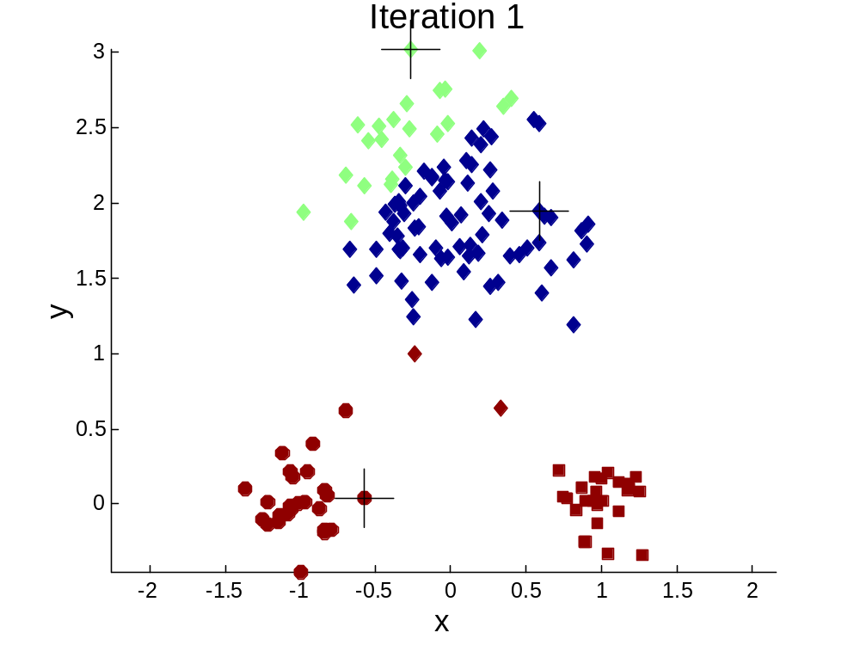


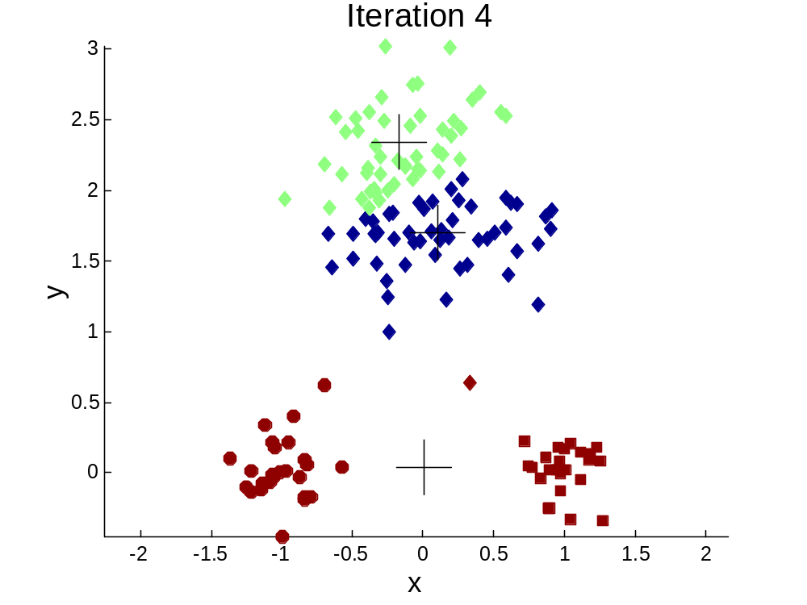
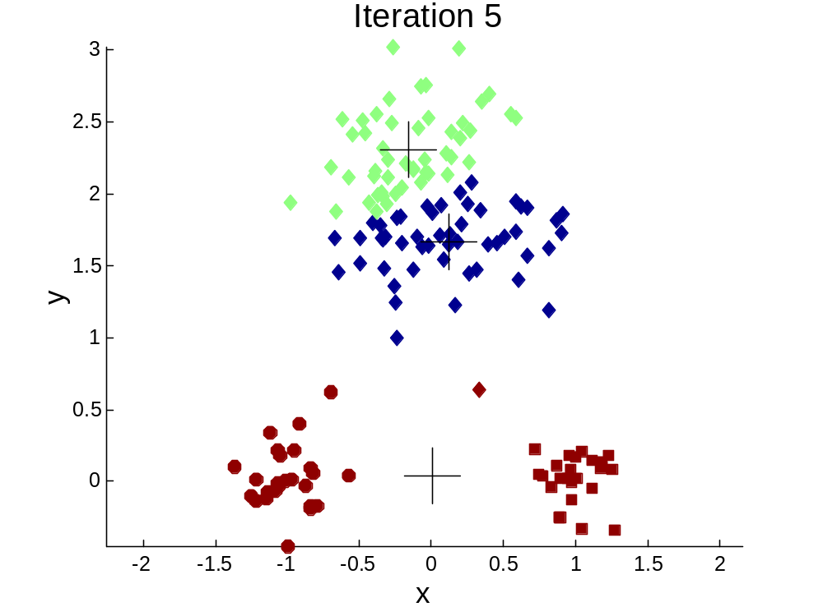
Importance of Choosing Initial Centroids …

Slide 25
Importance of Choosing Initial Centroids …

Slide 26
Solutions to Initial Centroids Problem
Multiple runs
  Helps, but probability is not on your side
Sample and use hierarchical clustering to determine initial centroids
Select more than k initial centroids and then select among these initial centroids
  Select most widely separated
Postprocessing
Bisecting K-means
  Not as susceptible to initialization issues

Slide 27
Handling Empty Clusters
Basic K-means algorithm can yield empty clusters
Several strategies
  Choose the point that contributes most to SSE
  Choose a point from the cluster with the highest SSE
  If there are several empty clusters, the above can be repeated several times.

Slide 28
Updating Centers Incrementally
In the basic K-means algorithm, centroids are updated after all points are assigned to a centroid
An alternative is to update the centroids after each assignment (incremental approach)
  Each assignment updates zero or two centroids
  More expensive
  Introduces an order dependency
  Never get an empty cluster
  Can use “weights” to change the impact

Slide 29
Pre-processing and Post-processing
Pre-processing
  Normalize the data
  Eliminate outliers
Post-processing
  Eliminate small clusters that may represent outliers
  Split ‘loose’ clusters, i.e., clusters with relatively high SSE
  Merge clusters that are ‘close’ and that have relatively low SSE

Slide 30

Bisecting K-means
Bisecting K-means algorithm
  Variant of K-means

Slide 31
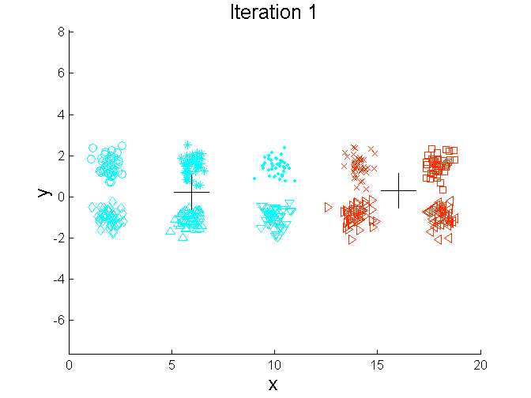
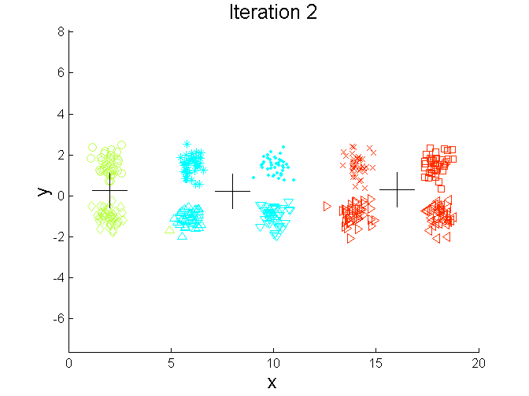
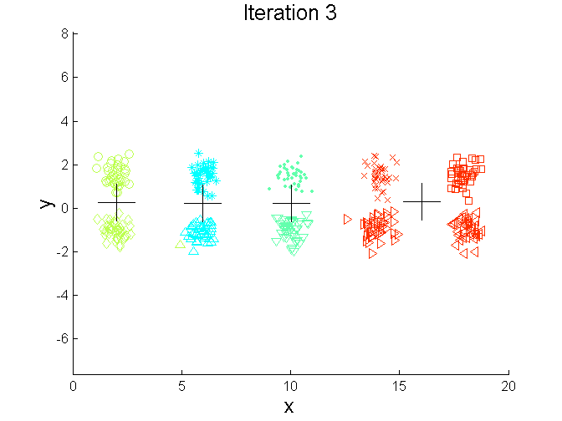
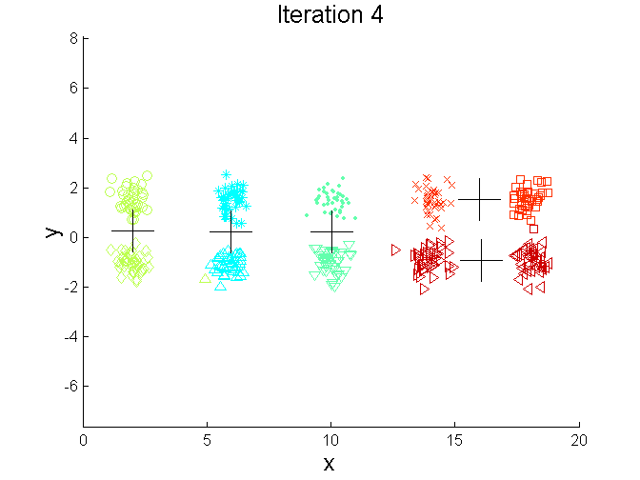
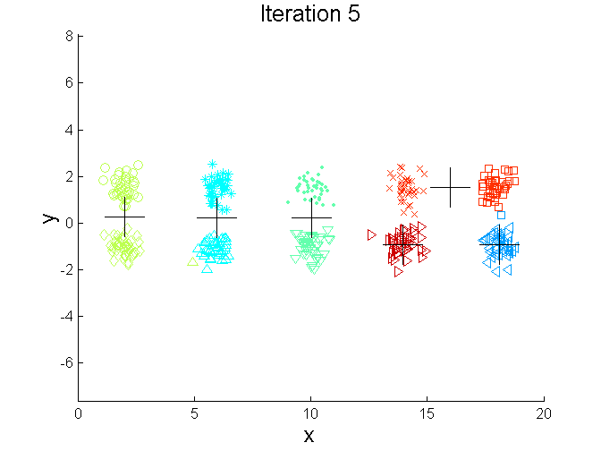
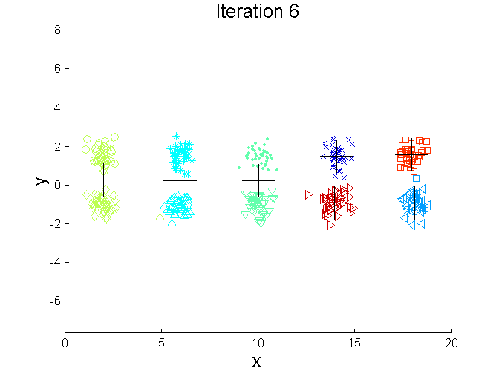
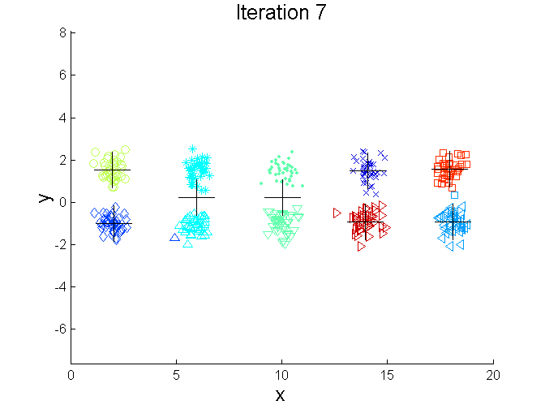
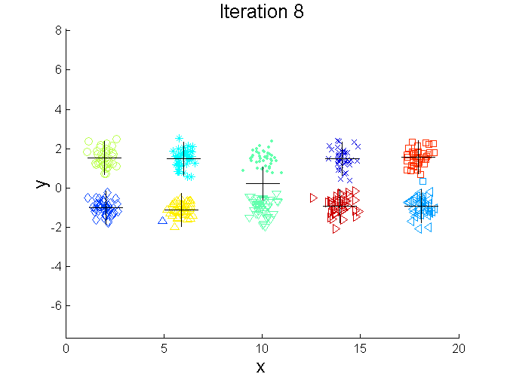
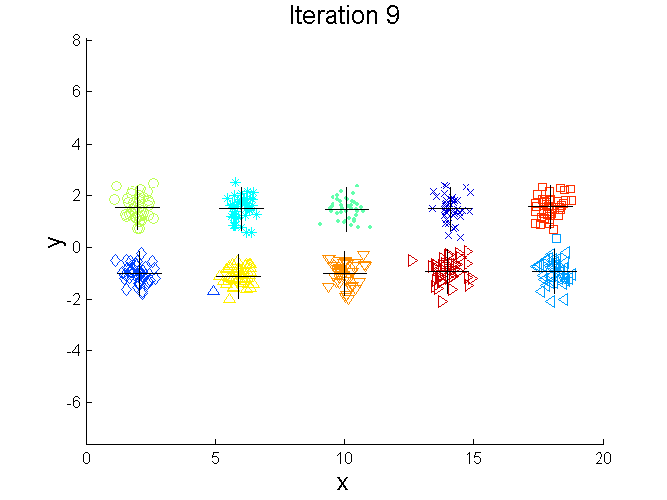
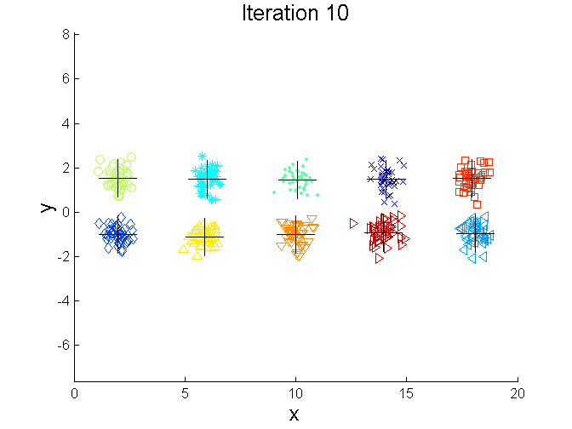
Bisecting K-means Example

Slide 32
Limitations of K-means
K-means has problems when clusters are of differing
  Sizes
  Densities
  Non-globular shapes
K-means has problems when the data contains outliers.

Slide 33


Limitations of K-means: Differing Sizes
Original Points
K-means (3 Clusters)

Slide 34


Limitations of K-means: Differing Density
Original Points
K-means (3 Clusters)

Slide 35


Limitations of K-means: Non-globular Shapes
Original Points
K-means (2 Clusters)

Slide 36

Overcoming K-means Limitations
Original Points K-means Clusters
One solution is to use many clusters.
  Find parts of clusters, but need to put together.

Slide 37
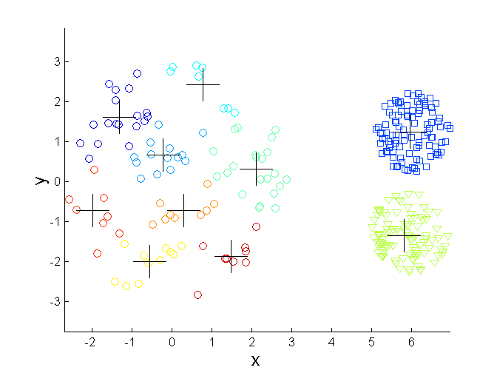
Overcoming K-means Limitations
Original Points K-means Clusters

Slide 38
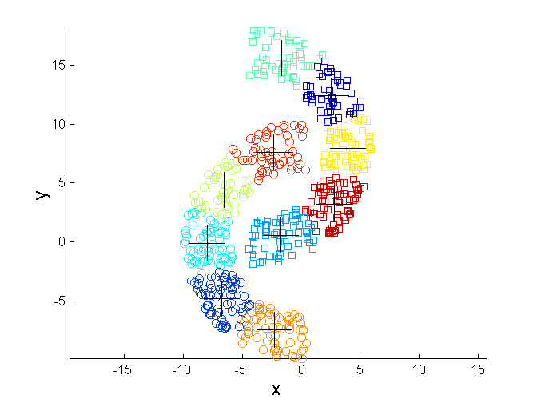
Overcoming K-means Limitations
Original Points K-means Clusters

Slide 39


Hierarchical Clustering
Produces a set of nested clusters organized as a hierarchical tree
Can be visualized as a dendrogram
  A tree like diagram that records the sequences of merges or splits

Slide 40
Strengths of Hierarchical Clustering
Do not have to assume any particular number of clusters
  Any desired number of clusters can be obtained by ‘cutting’ the dendogram at the proper level
They may correspond to meaningful taxonomies
  Example in biological sciences (e.g., animal kingdom, phylogeny reconstruction, …)

Slide 41
Hierarchical Clustering
Two main types of hierarchical clustering
  Agglomerative:
    Start with the points as individual clusters
    At each step, merge the closest pair of clusters until only one cluster (or k clusters) left
  Divisive:
    Start with one, all-inclusive cluster
    At each step, split a cluster until each cluster contains a point (or there are k clusters)
Traditional hierarchical algorithms use a similarity or distance matrix
  Merge or split one cluster at a time

Slide 42
Agglomerative Clustering Algorithm
More popular hierarchical clustering technique
Basic algorithm is straightforward
  Compute the proximity matrix
  Let each data point be a cluster
  Repeat
  Merge the two closest clusters
  Update the proximity matrix
  Until only a single cluster remains
Key operation is the computation of the proximity of two clusters
  Different approaches to defining the distance between clusters distinguish the different algorithms

Slide 43
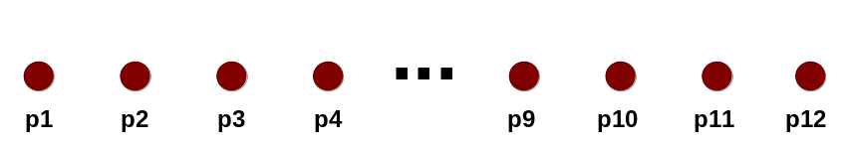
Starting Situation
Start with clusters of individual points and a proximity matrix
p1
p2
p3
p4
p5
. . .
p1
p2
p3
p4
p5
.
.
.
Proximity Matrix

Slide 44
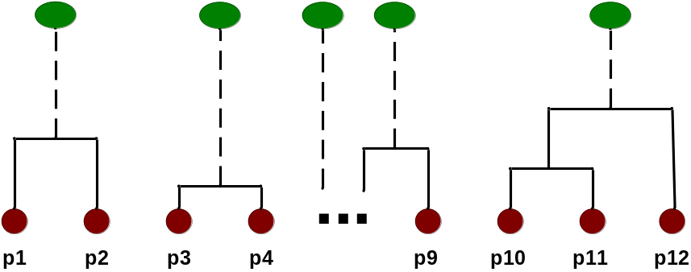
Intermediate Situation
After some merging steps, we have some clusters
C1
C2
C3
C4
C5
C1
C2
C3
C3
C4
C4
C5
Proximity Matrix
C1
C2
C5

Slide 45

Intermediate Situation
We want to merge the two closest clusters (C2 and C5) and update the proximity matrix.
C1
C2
C3
C4
C5
C1
C2
C3
C3
C4
C4
C5
Proximity Matrix
C1
C2
C5

Slide 46

After Merging
The question is “How do we update the proximity matrix?”
C2 U C5
C1
C3
C4
C1
?
C2 U C5
? ? ? ?
C3
C3
?
C4
C4
?
Proximity Matrix
C1
C2 U C5

Slide 47
How to Define Inter-Cluster Similarity
p1
p2
p3
p4
p5
. . .
p1
Similarity?
p2
p3
p4
p5
MIN
MAX
Group Average
Distance Between Centroids
Other methods driven by an objective function
  Ward’s Method uses squared error
.
.
.
Proximity Matrix

Slide 48
How to Define Inter-Cluster Similarity
p1
p2
p3
p4
p5
. . .
p1
p2
p3
p4
p5
MIN
MAX
Group Average
Distance Between Centroids
Other methods driven by an objective function
  Ward’s Method uses squared error
.
.
.
Proximity Matrix

Slide 49
How to Define Inter-Cluster Similarity
p1
p2
p3
p4
p5
. . .
p1
p2
p3
p4
p5
MIN
MAX
Group Average
Distance Between Centroids
Other methods driven by an objective function
  Ward’s Method uses squared error
.
.
.
Proximity Matrix

Slide 50
How to Define Inter-Cluster Similarity
p1
p2
p3
p4
p5
. . .
p1
p2
p3
p4
p5
MIN
MAX
Group Average
Distance Between Centroids
Other methods driven by an objective function
  Ward’s Method uses squared error
.
.
.
Proximity Matrix

Slide 51
How to Define Inter-Cluster Similarity
p1
p2
p3
p4
p5
. . .
p1
×
×
p2
p3
p4
p5
MIN
MAX
Group Average
Distance Between Centroids
Other methods driven by an objective function
  Ward’s Method uses squared error
.
.
.
Proximity Matrix

Slide 52
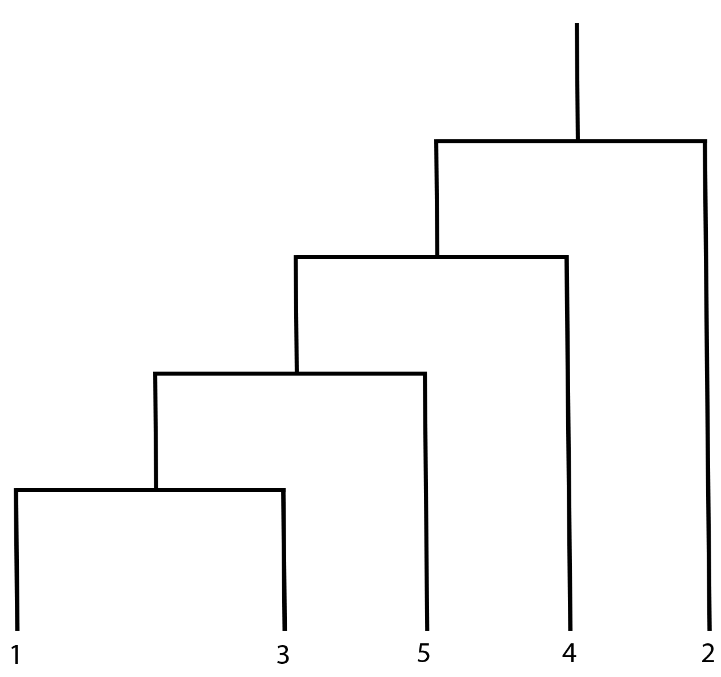
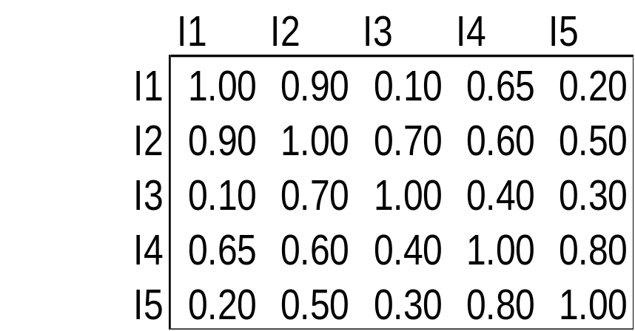
Cluster Similarity: MIN or Single Link
Similarity of two clusters is based on the two most similar (closest) points in the different clusters
  Determined by one pair of points, i.e., by one link in the proximity graph.

Slide 53

Hierarchical Clustering: MIN
5
1
3
5
2
1
2
3
6
4
4
Nested Clusters
Dendrogram

Slide 54
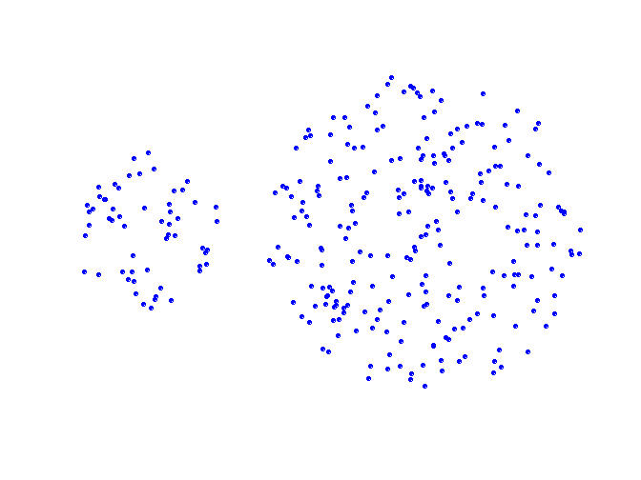
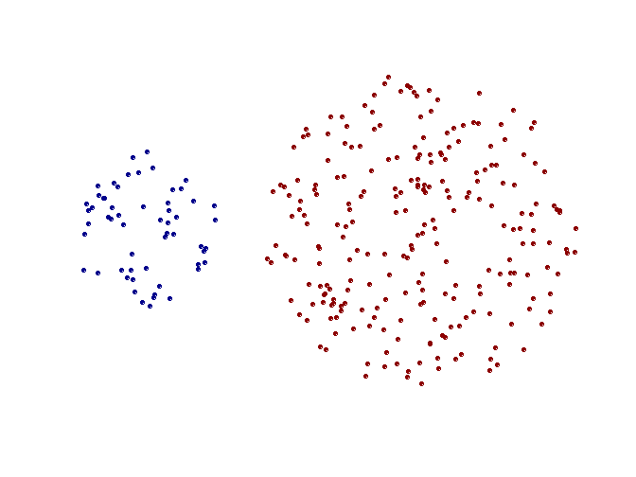
Strength of MIN
Original Points
Two Clusters
Can handle non-elliptical shapes

Slide 55
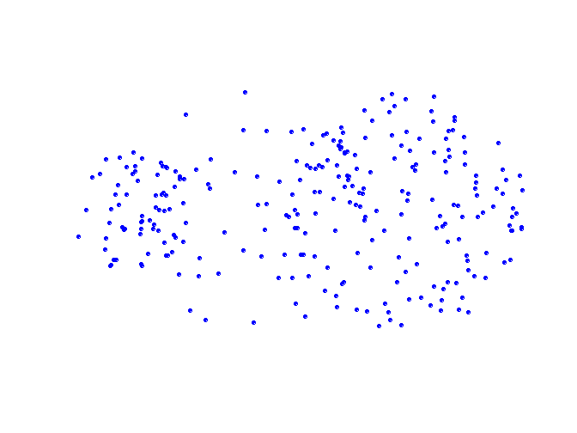
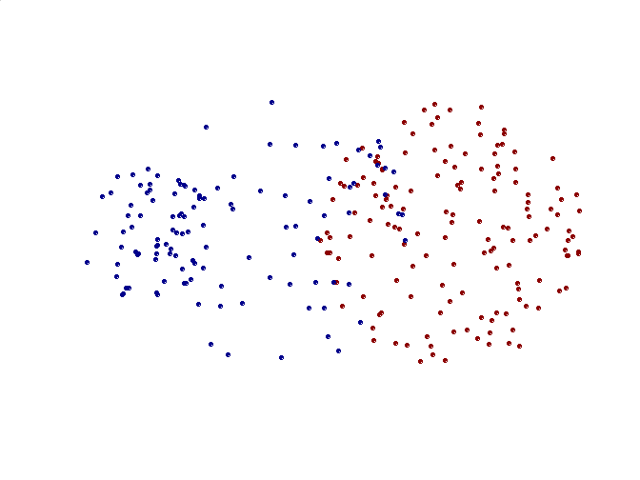
Limitations of MIN
Original Points
Two Clusters
Sensitive to noise and outliers

Slide 56

Cluster Similarity: MAX or Complete Linkage
Similarity of two clusters is based on the two least similar (most distant) points in the different clusters
  Determined by all pairs of points in the two clusters
1
2
3
4
5

Slide 57
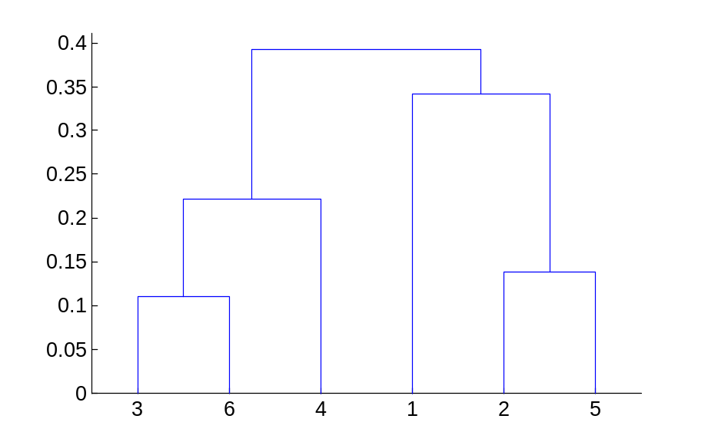
Hierarchical Clustering: MAX
4
1
2
5
5
2
3
6
3
1
4
Nested Clusters
Dendrogram

Slide 58
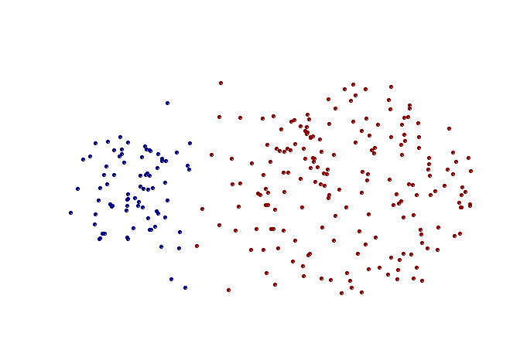
Strength of MAX
Original Points
Two Clusters
Less susceptible to noise and outliers

Slide 59
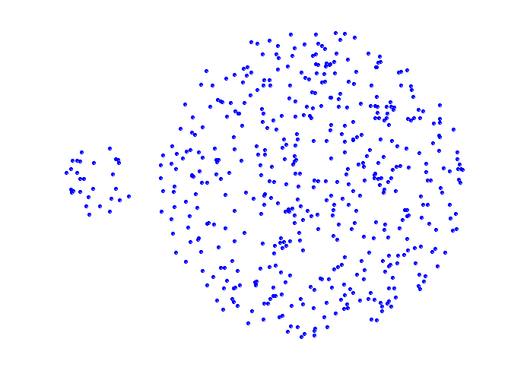
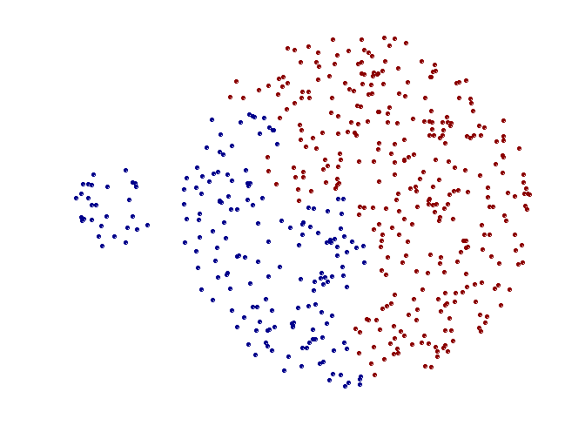
Limitations of MAX
Original Points
Two Clusters
Tends to break large clusters
Biased towards globular clusters

Slide 60
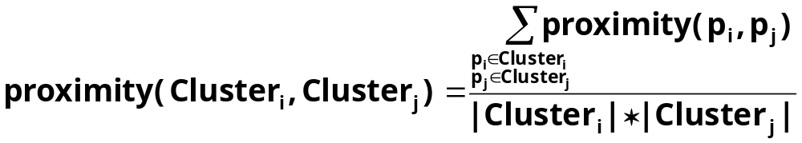

Cluster Similarity: Group Average
Proximity of two clusters is the average of pairwise proximity between points in the two clusters.
Need to use average connectivity for scalability since total proximity favors large clusters
1
2
3
4
5

Slide 61

Hierarchical Clustering: Group Average
5
4
1
2
5
2
3
6
1
4
3
Nested Clusters
Dendrogram

Slide 62
Hierarchical Clustering: Group Average
Compromise between Single and Complete Link
Strengths
  Less susceptible to noise and outliers
Limitations
  Biased towards globular clusters

Slide 63
Cluster Similarity: Ward’s Method
Similarity of two clusters is based on the increase in squared error when two clusters are merged
  Similar to group average if distance between points is distance squared
Less susceptible to noise and outliers
Biased towards globular clusters
Hierarchical analogue of K-means
  Can be used to initialize K-means

Slide 64
Hierarchical Clustering: Comparison
5
1
4
1
3
2
5
5
5
2
1
MIN
2
MAX
2
3
6
3
3
6
1
4
4
4
5
5
1
4
1
2
2
5
2
Ward’s Method
5
2
3
6
Group Average
3
3
6
4
1
1
4
4
3

Slide 65
Hierarchical Clustering: Time and Space requirements
O(N²) space since it uses the proximity matrix.
  N is the number of points.
O(N³) time in many cases
  There are N steps and at each step the size, N², proximity matrix must be updated and searched
  Complexity can be reduced to O(N² log(N) ) time for some approaches

Slide 66
Hierarchical Clustering: Problems and Limitations
Once a decision is made to combine two clusters, it cannot be undone
No objective function is directly minimized
Different schemes have problems with one or more of the following:
  Sensitivity to noise and outliers
  Difficulty handling different sized clusters and convex shapes
  Breaking large clusters

Slide 67
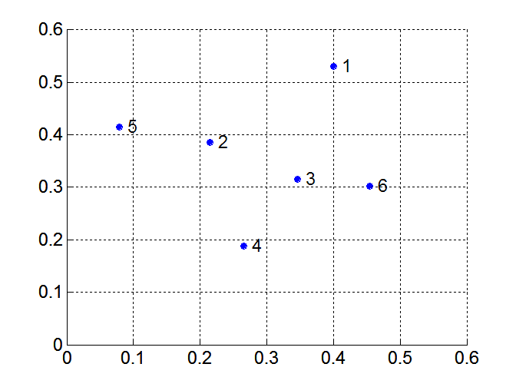
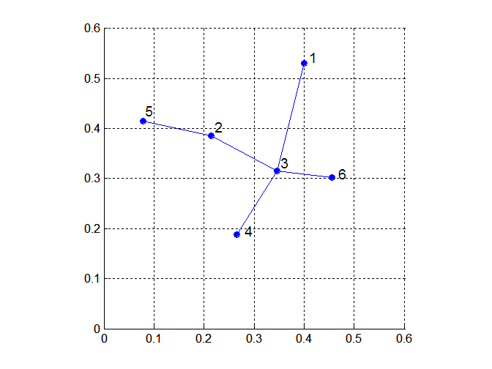
MST: Divisive Hierarchical Clustering
Build MST (Minimum Spanning Tree)
  Start with a tree that consists of any point
  In successive steps, look for the closest pair of points (p, q) such that one point (p) is in the current tree but the other (q) is not
  Add q to the tree and put an edge between p and q

Slide 68
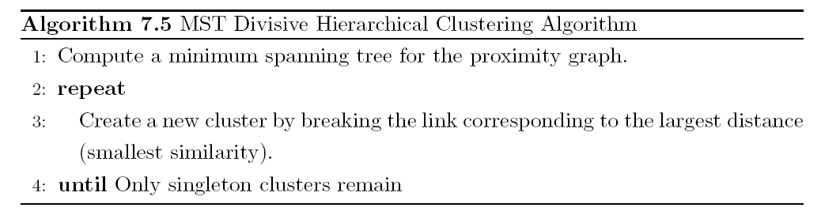
MST: Divisive Hierarchical Clustering
Use MST for constructing hierarchy of clusters

Slide 69
DBSCAN
DBSCAN is a density-based algorithm.
  Density = number of points within a specified radius (Eps)
  A point is a core point if it has more than a specified number of points (MinPts) within Eps
    These are points that are at the interior of a cluster
  A border point has fewer than MinPts within Eps, but is in the neighborhood of a core point
  A noise point is any point that is not a core point or a border point.

Slide 70

DBSCAN: Core, Border, and Noise Points

Slide 71
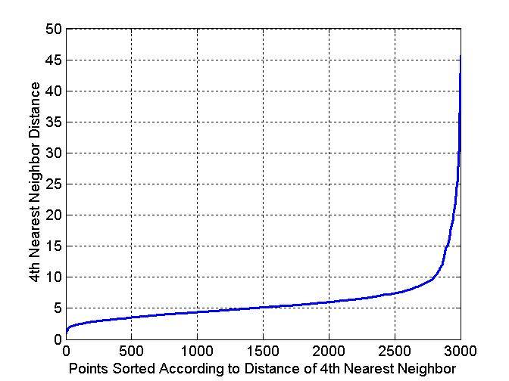
DBSCAN: Determining EPS and MinPts
Idea is that for points in a cluster, their k^{th} nearest neighbors are at roughly the same distance
Noise points have the k^{th} nearest neighbor at farther distance
So, plot sorted distance of every point to its k^{th} nearest neighbor

Slide 72
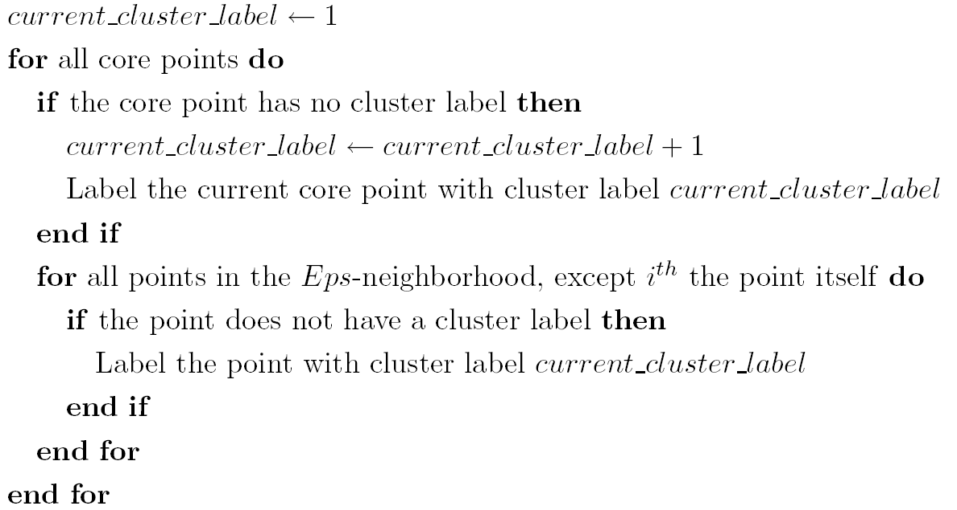
DBSCAN Algorithm
Eliminate noise points
Perform clustering on the remaining points

Slide 73


DBSCAN: Core, Border and Noise Points
Original Points
Point types: core, border and noise
Eps = 10, MinPts = 4

Slide 74

When DBSCAN Works Well
Original Points
Clusters
Resistant to Noise
Can handle clusters of different shapes and sizes

Slide 75



When DBSCAN Does NOT Work Well
(MinPts=4, Eps=9.75).
Original Points
Varying densities
High-dimensional data
(MinPts=4, Eps=9.92)

Slide 76
Cluster Validity
For supervised classification we have a variety of measures to evaluate how good our model is
  Accuracy, precision, recall
For cluster analysis, the analogous question is how to evaluate the “goodness” of the resulting clusters?
But “clusters are in the eye of the beholder”!
Then why do we want to evaluate them?
  To avoid finding patterns in noise
  To compare clustering algorithms
  To compare two sets of clusters
  To compare two clusters

Slide 77
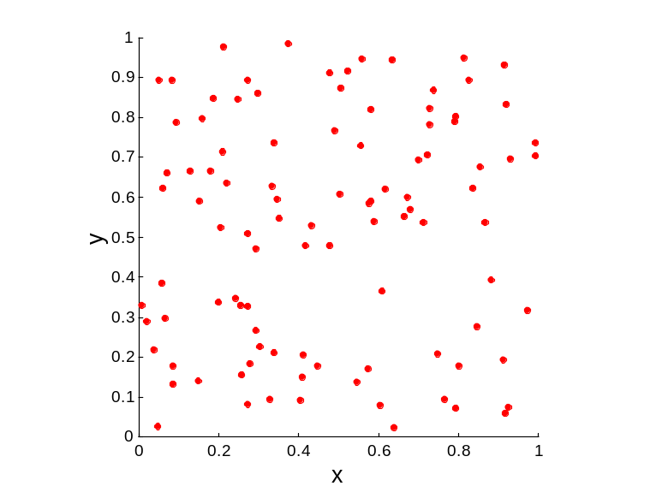
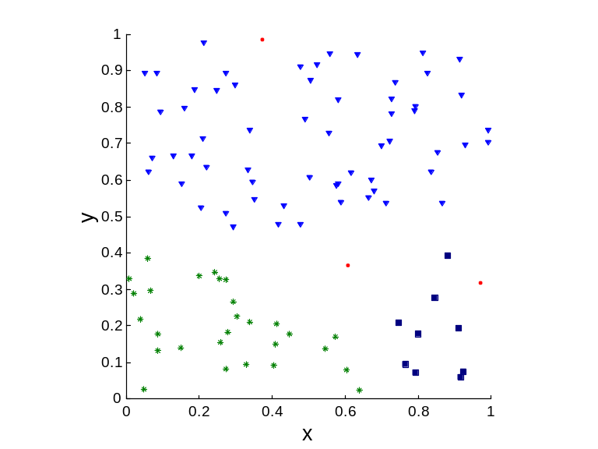
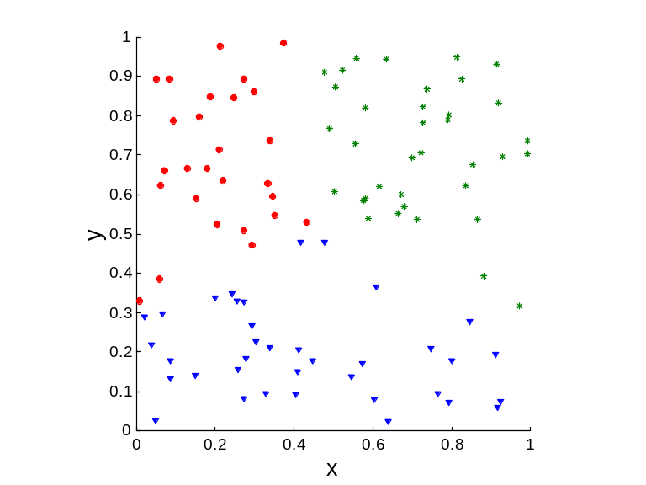
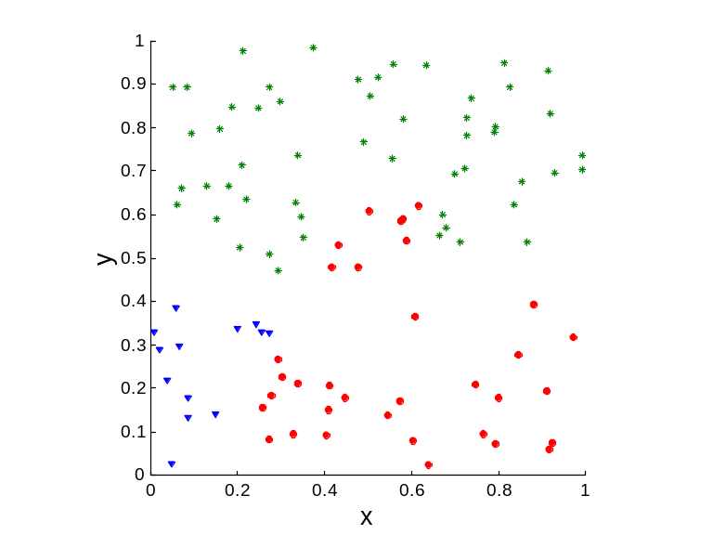
Clusters found in Random Data
Random Points
DBSCAN
K-means
Complete Link

Slide 78
Different Aspects of Cluster Validation
Determining the clustering tendency of a set of data, i.e., distinguishing whether non-random structure actually exists in the data.
Comparing the results of a cluster analysis to externally known results, e.g., to externally given class labels.
Evaluating how well the results of a cluster analysis fit the data without reference to external information.
  - Use only the data
Comparing the results of two different sets of cluster analyses to determine which is better.
Determining the ‘correct’ number of clusters.
For 2, 3, and 4, we can further distinguish whether we want to evaluate the entire clustering or just individual clusters.

Slide 79
Measures of Cluster Validity
Numerical measures that are applied to judge various aspects of cluster validity, are classified into the following three types.
  External Index: Used to measure the extent to which cluster labels match externally supplied class labels.
    Entropy
  Internal Index: Used to measure the goodness of a clustering structure without respect to external information.
    Sum of Squared Error (SSE)
  Relative Index: Used to compare two different clusterings or clusters.
    Often an external or internal index is used for this function, e.g., SSE or entropy
Sometimes these are referred to as criteria instead of indices
  However, sometimes criterion is the general strategy and index is the numerical measure that implements the criterion.

Slide 80
Measuring Cluster Validity Via Correlation
Two matrices
  Proximity Matrix
  “Incidence” Matrix
    One row and one column for each data point
    An entry is 1 if the associated pair of points belong to the same cluster
    An entry is 0 if the associated pair of points belongs to different clusters
Compute the correlation between the two matrices
  Since the matrices are symmetric, only the correlation between
  n(n-1) / 2 entries needs to be calculated.
High correlation indicates that points that belong to the same cluster are close to each other.
Not a good measure for some density or contiguity based clusters.

Slide 81
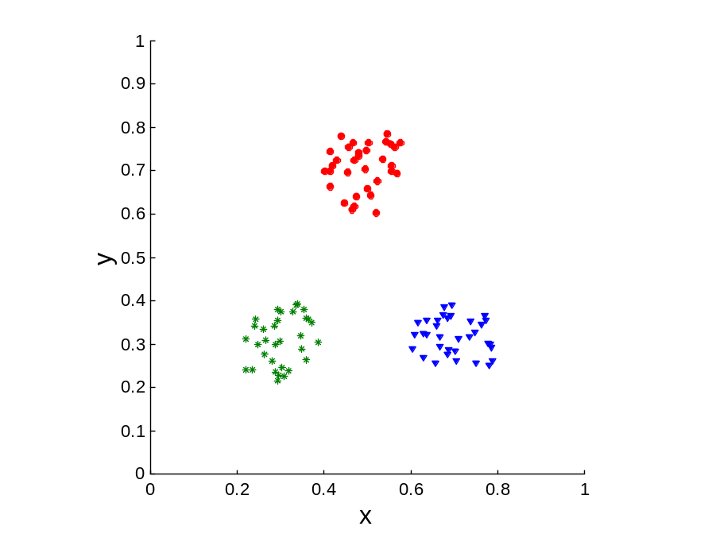
Measuring Cluster Validity Via Correlation
Correlation of incidence and proximity matrices for the K-means clusterings of the following two data sets.
Corr = -0.9235
Corr = -0.5810

Slide 82
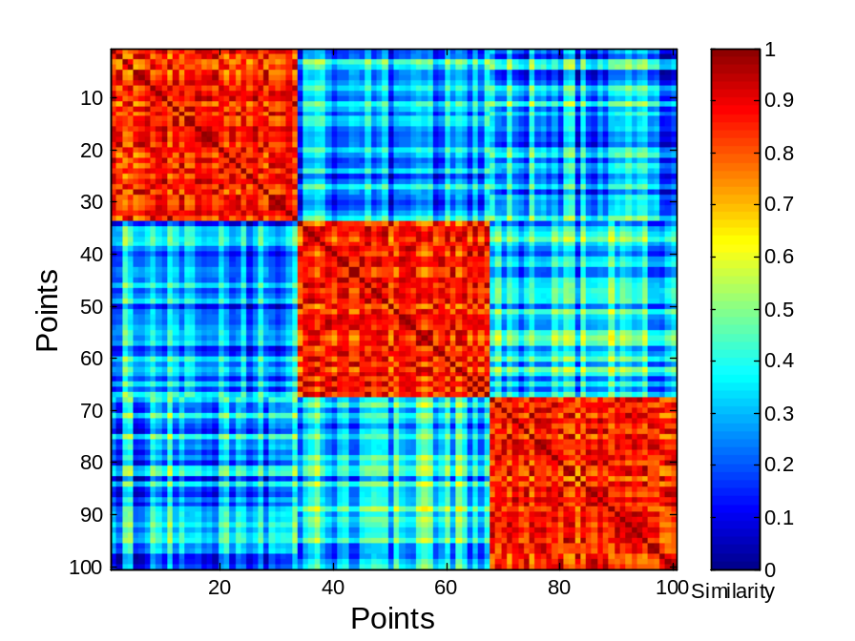
Using Similarity Matrix for Cluster Validation
Order the similarity matrix with respect to cluster labels and inspect visually.

Slide 83
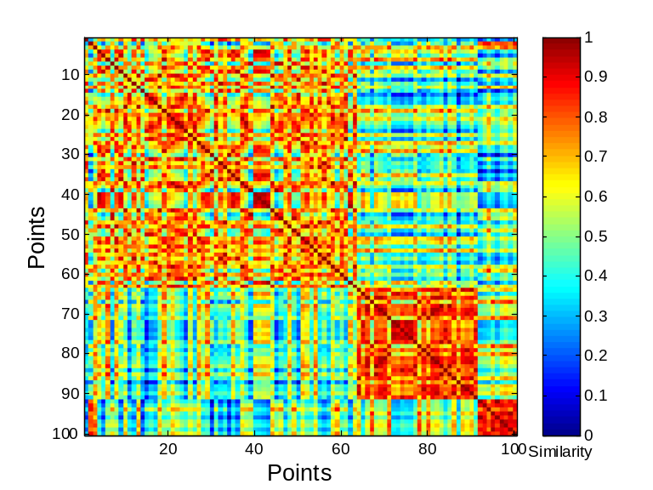
Using Similarity Matrix for Cluster Validation
Clusters in random data are not so crisp
DBSCAN

Slide 84
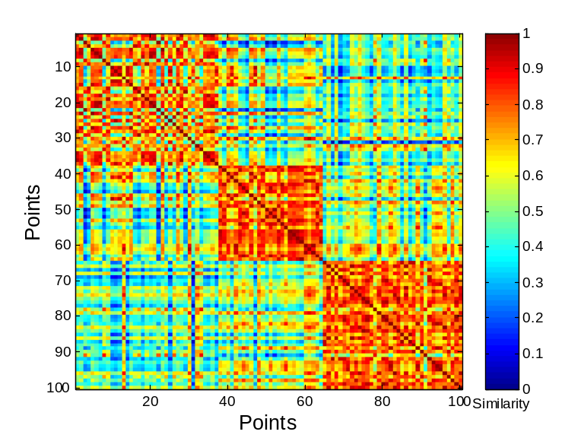
Using Similarity Matrix for Cluster Validation
Clusters in random data are not so crisp
K-means

Slide 85
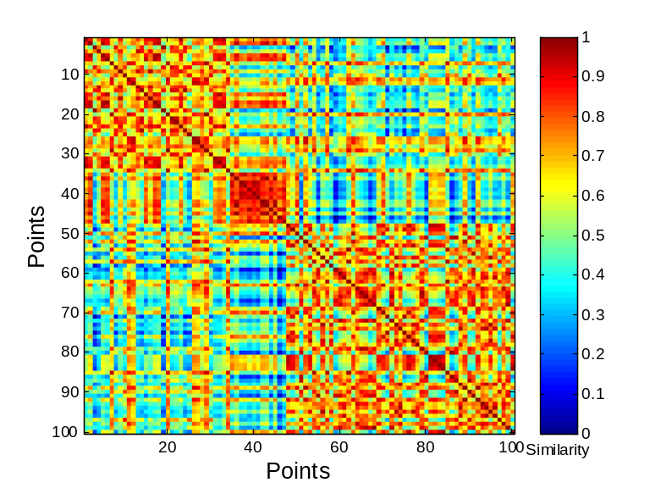
Using Similarity Matrix for Cluster Validation
Clusters in random data are not so crisp
Complete Link

Slide 86
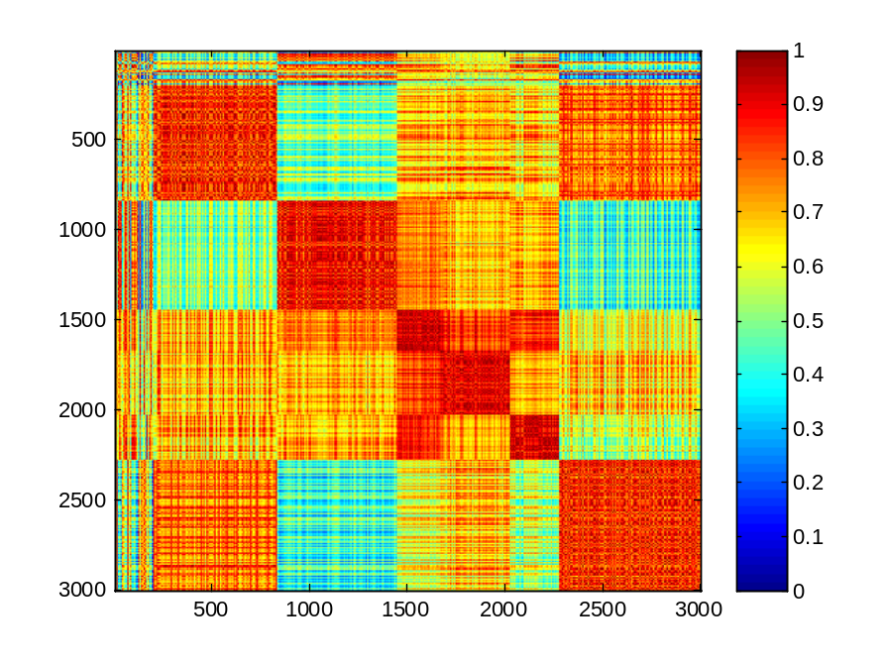
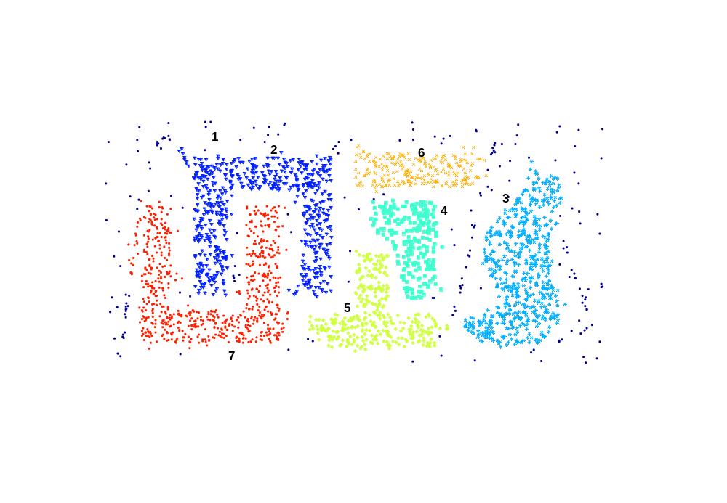
Using Similarity Matrix for Cluster Validation
DBSCAN

Slide 87
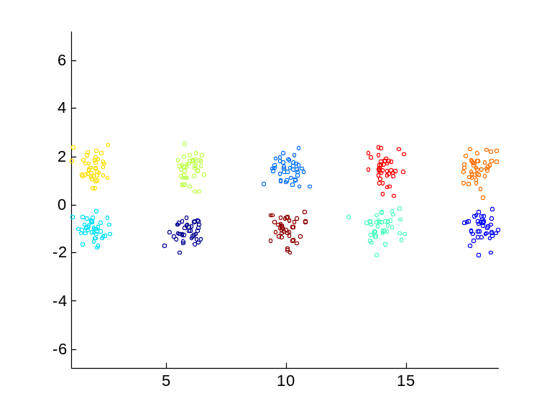

Internal Measures: SSE
Clusters in more complicated figures aren’t well separated
Internal Index: Used to measure the goodness of a clustering structure without respect to external information
  SSE
SSE is good for comparing two clusterings or two clusters (average SSE).
Can also be used to estimate the number of clusters

Slide 88

Internal Measures: SSE
SSE curve for a more complicated data set
SSE of clusters found using K-means

Slide 89
Framework for Cluster Validity
Need a framework to interpret any measure.
  For example, if our measure of evaluation has the value, 10, is that good, fair, or poor?
Statistics provide a framework for cluster validity
  The more “atypical” a clustering result is, the more likely it represents valid structure in the data
  Can compare the values of an index that result from random data or clusterings to those of a clustering result.
    If the value of the index is unlikely, then the cluster results are valid
  These approaches are more complicated and harder to understand.
For comparing the results of two different sets of cluster analyses, a framework is less necessary.
  However, there is the question of whether the difference between two index values is significant

Slide 90

Statistical Framework for SSE
Example
  Compare SSE of 0.005 against three clusters in random data
  Histogram shows SSE of three clusters in 500 sets of random data points of size 100 distributed over the range 0.2 – 0.8 for x and y values

Slide 91

Statistical Framework for Correlation
Correlation of incidence and proximity matrices for the K-means clusterings of the following two data sets.
Corr = -0.9235
Corr = -0.5810

Slide 92


Internal Measures: Cohesion and Separation
Cluster Cohesion: Measures how closely related are objects in a cluster
  Example: SSE
Cluster Separation: Measure how distinct or well-separated a cluster is from other clusters
Example: Squared Error
  Cohesion is measured by the within cluster sum of squares (SSE)
  Separation is measured by the between cluster sum of squares
      Where |C_{i}| is the size of cluster i

Slide 93


Internal Measures: Cohesion and Separation
Example: SSE
  BSS + WSS = constant
m
×
×
×
1
m₁
2
3
4
m₂
5
K=1 cluster:
K=2 clusters:

Slide 94
Internal Measures: Cohesion and Separation
A proximity graph based approach can also be used for cohesion and separation.
  Cluster cohesion is the sum of the weight of all links within a cluster.
  Cluster separation is the sum of the weights between nodes in the cluster and nodes outside the cluster.
cohesion
separation

Slide 95

Internal Measures: Silhouette Coefficient
Silhouette Coefficient combine ideas of both cohesion and separation, but for individual points, as well as clusters and clusterings
For an individual point, i
  Calculate a = average distance of i to the points in its cluster
  Calculate b = min (average distance of i to points in another cluster)
  The silhouette coefficient for a point is then given by
  s = 1 – a/b if a < b, (or s = b/a - 1 if a ≥ b, not the usual case)
  Typically between 0 and 1.
  The closer to 1 the better.
Can calculate the Average Silhouette width for a cluster or a clustering

Slide 96

External Measures of Cluster Validity: Entropy and Purity

Slide 97
Final Comment on Cluster Validity
“The validation of clustering structures is the most difficult and frustrating part of cluster analysis.
Without a strong effort in this direction, cluster analysis will remain a black art accessible only to those true believers who have experience and great courage.”
Algorithms for Clustering Data, Jain and Dubes

